Slide 1
25th ward ashland AVE - cullerton to 18th Pl
July 2026

Slide 2
Traffic study process
Study Need
Ward Office
CDOT Liaison
CDOT Traffic Design
Constituent complaint
Known safety concern
Change in the roadway network
Ward collects information related to the study need
Ward handles communications with residents
Liaison facilitates communications between the Ward and CDOT as needed
Liaison helps Ward understand menu process, including funding options and construction timelines
Ward Prepares Request Form
Receives Request Form
Does additional research and data collection
Prepares a Traffic Study with recommendations for the Ward to consider
The Ward is encouraged to engage with constituents as the Traffic Study Recommendations are considered
Notes:
Community reaches out to ward, ward communicates with CDOT, recommendations to ward

Slide 3
CDOT COMPLETE STREETS
Transforming our streets into safe, equitable, inviting spaces for all - regardless of age, ability, or travel mode.
Parks & Schools Safety
Fatal Crash Response
Pedestrian Safety
High Injury Network
Cycling Network
Neighborhood traffic calming
Bus stop accessibility
Areas of Work:
Addresses crash circumstances and other safety needs on corridor
PROJECT TYPES:
Rapid Delivery – quick implementation, interim materials
Long Term projects – concrete
Notes:
What we’re doing as a dept – what are the results
This is what we do as a department when there are fatalities
Success in reducing fatalities
CS/Traffic Safety
One program – responding to FC, review, develop potential actions, respond accordingly – this is that effort

Slide 4
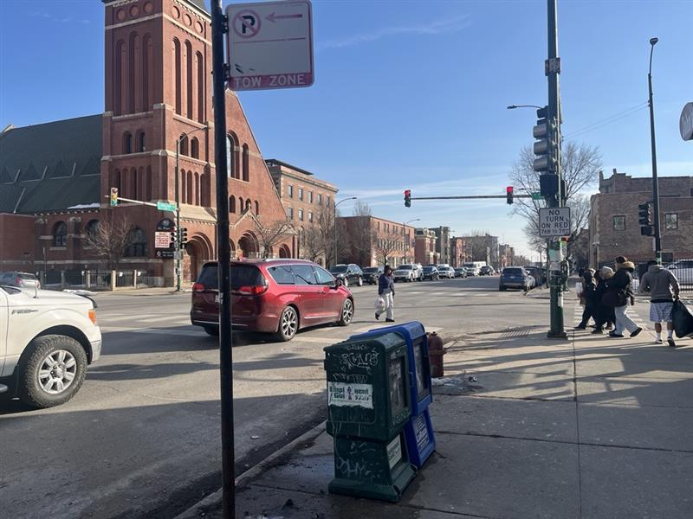
TRAFFIC STUDY Request
Received from Ward 25 in July 2025
  Pedestrian safety concerns on Ashland Ave, particularly at Cullerton Ave.
  Reviewed traffic patterns, crash history, bus/signal operations
Community Coordination
  Meetings with St. Pius and 25th Ward representatives in fall 2025 and spring 2026
Outcomes
  Ward funding for pedestrian refuge island/signage improvements at Cullerton
  CDOT Complete Streets funding additional improvements along the corridor
Notes:
Ongoing coordination and work between CDOT and the ward
This is construction update meeting and to share design

Slide 5
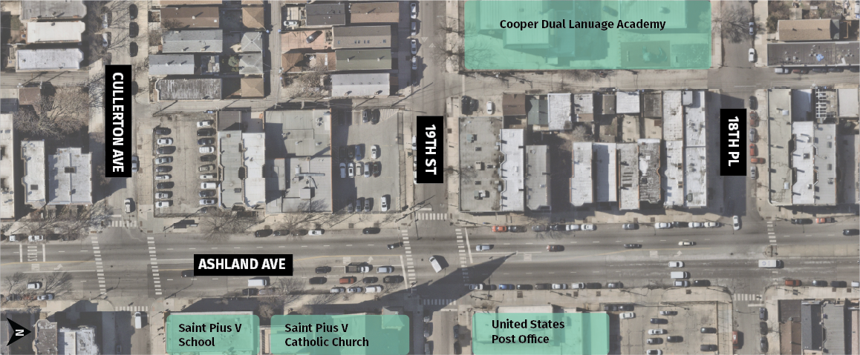
Ashland AVE – Cullerton to 18th pl

Slide 6
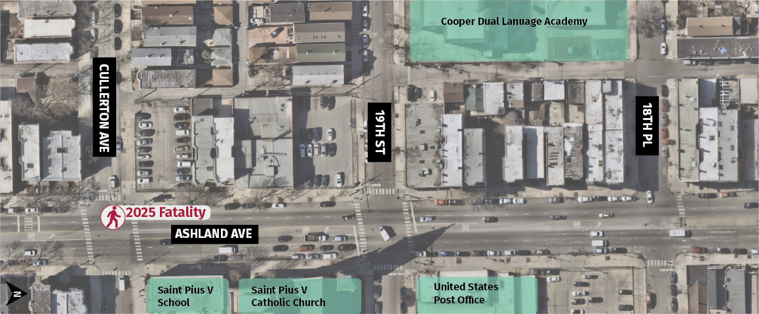
Ashland AVE – Cullerton to 18th pl
Notes:
Marcela Herrera – 23 yo pedestrian victim
Hit and Run driver
Crossing Ashland EB at Cullerton, U1 overtook traffic in median and struck pedestrians.

Slide 7
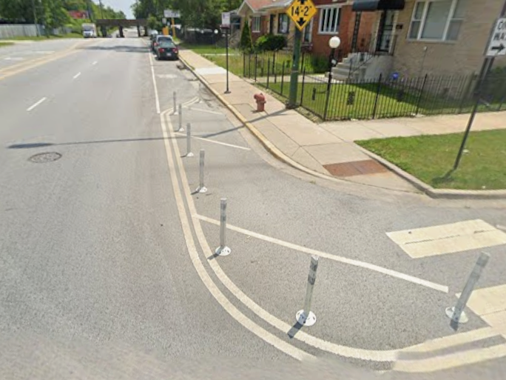
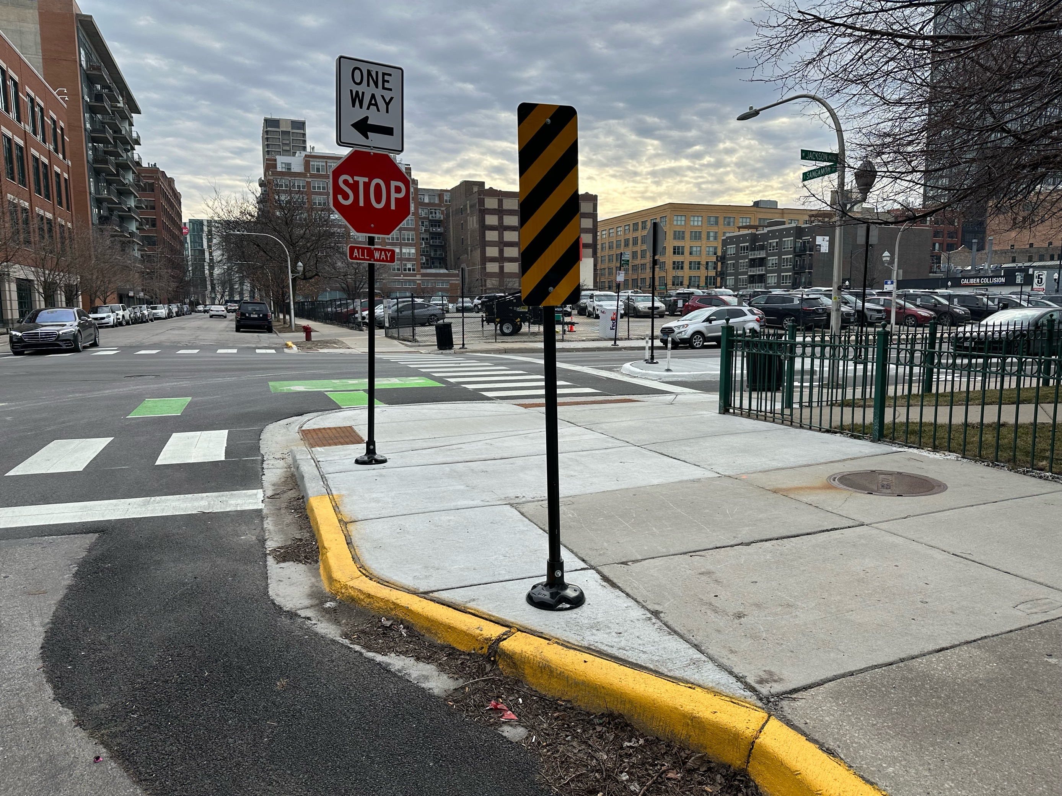
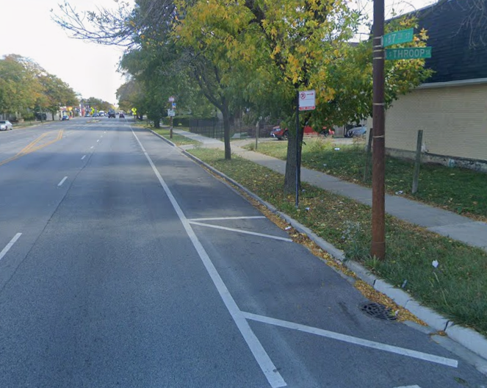
Safety toolbox – typical items
Rapid Delivery
Curb Bumpouts
Attached
Curb Bumpout
Pedestrian
Refuge Island
Parking
Lane Lines
Notes:
Typical traffic calming toolbox
Make crossing the street safer and more comfortable for pedestrians
Improve pedestrian visibility
Slow drivers and increase yielding

Slide 8
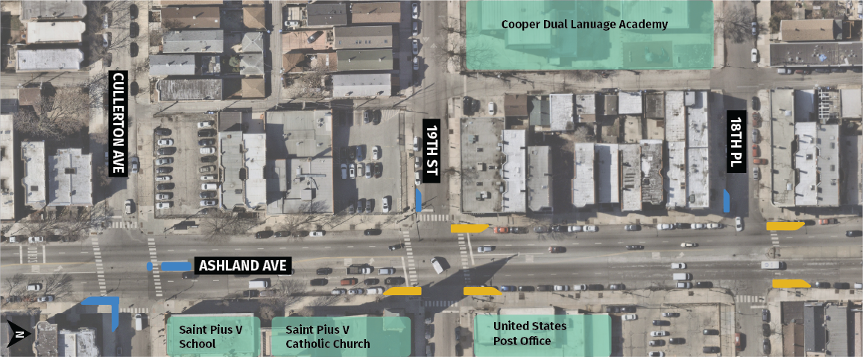
PLANNED Design – 2026 installations
Rapid Delivery Improvement – Temporary Materials to Be Upgraded
Concrete Improvement
Notes:
West side – thinking about what improvements will go there in 2027
RDP – no MMA as part of installs
Designed to address safety at key Ashland crossings
Prioritize safety surrounding schools
Phased installation in 2026 and 2027
Make crossing the street safer and more comfortable for pedestrians
Improve pedestrian visibility
Slow drivers and increase yielding

Slide 9
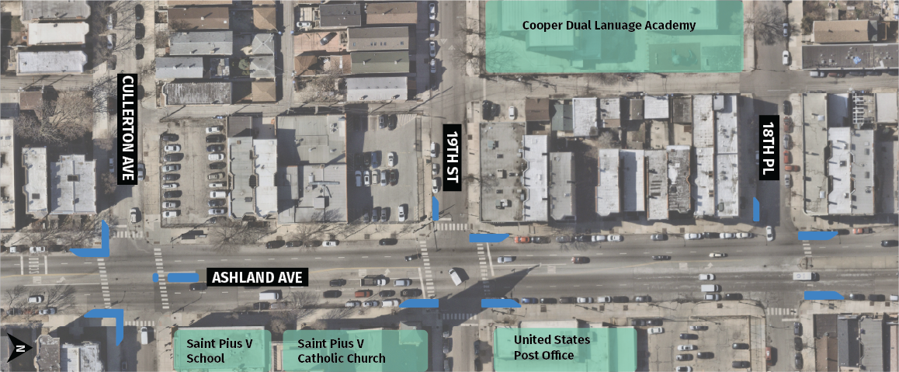
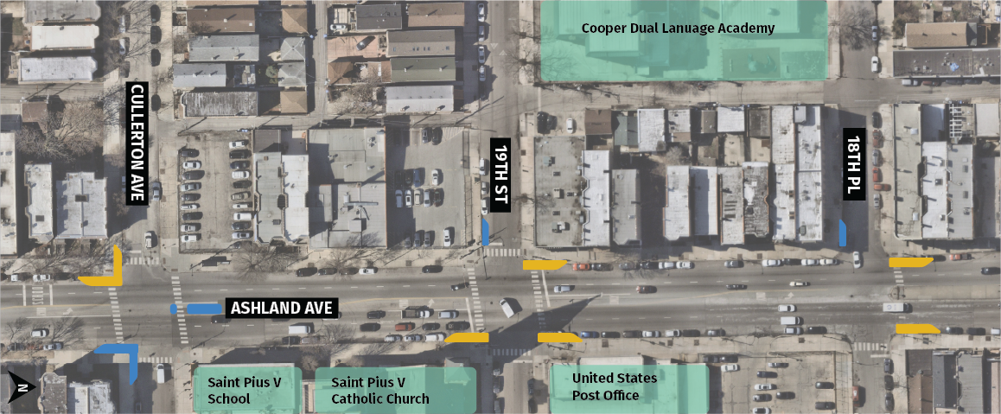
PLANNED Design – 2026 + 2027 installations
Concrete Improvement
Notes:
Designed to address safety at key Ashland crossings
Prioritize safety surrounding schools
Phased installation in 2026 and 2027
Make crossing the street safer and more comfortable for pedestrians
Improve pedestrian visibility
Slow drivers and increase yielding

Slide 10
Proposed timeline
Fall 2026
  Anticipated construction
    Pedestrian Refuge Island Installation – Cullerton (Ward-funded)
    Strategic Concrete Bumpout Installation
    Rapid Delivery Installation
2027
  Upgrade rapid delivery installation to concrete
Notes:
Coordination with the school, minimal construction impacts
Finalizing design and handing off the project to the construction team in the near future

